Slide 1
Interpolation & Curve Fitting: Least Square Approximations
Notes:
Pierre Étienne Bézier (September 1, 1910 – November 25, 1999) (pronounced "bay zee ay“)
Received his Ph.D. in mathematics at age 67, (1977)

Slide 2
Curve Fitting
Measurement errors are inevitable in observational and experimental sciences
Errors can be smoothed out by averaging over many cases, i.e., taking more measurements than that are necessary to determine the parameters of system
Resulting system is over-determined, so usually there is no exact solution

Slide 3
Curve Fitting
Given m data points (x_{i}, y_{i}), find an n-vector a of parameters that gives “best fit” to a model function y = f(x, a),
A linear problem if
function f is linear in components of a
it can be written in matrix form as Aa≈b with A_{ij} =ψ_{j}(x_{i}) and b_{i}=y_{i}
Least Square Approximation

Slide 4
Linear and Nonlinear Curve Fitting Examples
Linear: Polynomial fitting
is linear, since the polynomial is linear in coefficients, though nonlinear in independent variable x
Nonlinear: fitting sum of exponentials
is an example of nonlinear problem
We will only consider linear least squares problems for now

Slide 5
A Toy Example
Fitting a quadratic polynomial to five data points gives a linear least squares problem

Slide 6
Example: curve fitting (cont.)
For data x -1.0 -0.5 0.0 0.5 1.0
y 1.0 0.5 0.0 0.5 2.0
overdetermined linear system is
Solution, which we will see later how to compute, is

Slide 7
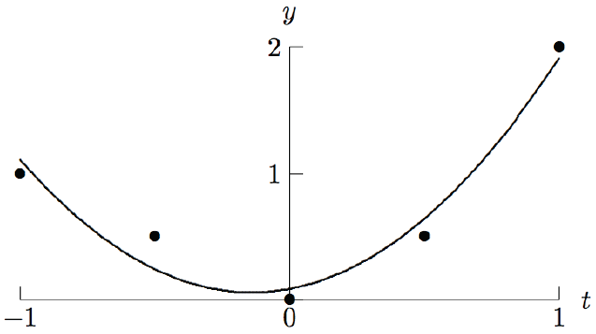
Example: curve fitting (cont.)
The computed approximation polynomial is
Resulting curve and original data points are shown in graph

Slide 8
Least Square Approximations
A way for curve fitting in “least square sense”
Higher dimensional data are projected into lower dimensional space to suppress irrelevant details
Such projection is most conveniently accomplished by the least square method
Linear projection from 2D to 1D space:
Original data distributed in a 2D space
They can be approximated as a 1D line
or 1D curve

Slide 9
Linear Least Squares
For linear problems, we obtain an over-determined linear system Aa = b with m×n matrix A, m > n
System is better written as Aa ≈ b, since equality is usually not exactly satisfied when m > n
Least squares solution a minimizes a squared Euclidean norm of residual vector r = b - Aa

Slide 10
Normal Equations
To minimize squared Euclidean norm of residual vector
Take derivative with respect to a and set it to 0
which reduces to an n×n linear system of normal equations

Slide 11
Geometric Interpretation of Normal Equations
Geometric relationships among b, r, and span(A) are shown in diagram
r is orthogonal to the column space of A
Notes:
If r is orthogonal to span(A), then its bases , i.e., all columns of A should be orthogonal to r.
Let A = [A1, A2, …, An], then (A1)’r = 0, (A2)’r=0, … (An)’r = 0 (the inner product of each column vector and r is zero)
This is equivalent to A’r = 0;

Slide 12
Orthogonality
Space spanned by columns of m × n matrix A,
, is of dimension at most n
If m > n, b generally does not lie in span(A), so there is no exact solution to Aa = b
Vector y = Aa in span(A) closest to b in 2-norm occurs when residual r = b - Aa is orthogonal to span(A),
This gives the linear system

Slide 13
Side note: Pseudoinverse for solving Aa = b
Nonsquare m × n matrix A has no inverse in usual sense
The least square solution of Aa = b is
In general, if rank(A) = n, the pseudoinverse is defined by

Slide 14
Condition Number of Rectangular Matrix
If rank(A) = n, pseudoinverse is defined by
and condition number by
By convention, cond(A) = ∞ if rank(A) < n
The condition number of a rectangular matrix measures the closeness to rank deficiency

Slide 15
Condition Number of Rectangular Matrix
The condition number of a square matrix measures the closeness to singularity
The condition number of a rectangular matrix measures the closeness to rank deficiency
Least squares solution of Aa≈b is given by a=A⁺b

Slide 16
Sensitivity and Conditioning
Sensitivity of least squares solution to Aa≈b depends on b as well as A
Define angle θ between b and y = Aa by
Bound on perturbation ∆a in solution a due to perturbation ∆b in b is given by

Slide 17
(from Chap2_3)

Slide 18
Sensitivity and Conditioning
Similarly, for perturbation E in matrix A,
Error of least squares solution is about cond(A) if residual is small, but can be squared or arbitrarily worse for large residual

Slide 19
Normal Equation Method
If m × n matrix A has rank n, then symmetric n × n matrix A^{T}A is positive definite, so its Cholesky factorization
can be used to obtain solution a to system of normal equations
which has the same solution as the linear least squares problem Aa≈b
Normal equations method involves transformations: rectangular → square → triangular

Slide 20
Example: Normal Equation Method
For polynomial data-fitting on
x -1.0 -0.5 0.0 0.5 1.0
y 1.0 0.5 0.0 0.5 2.0
Normal equations method gives

Slide 21
Example: Normal Equation Method
For polynomial data-fitting on
x -1.0 -0.5 0.0 0.5 1.0
y 1.0 0.5 0.0 0.5 2.0
Normal equations method gives

Slide 22
Example (cont.)
Choleskey factorization of symmetric positive definite matrix A^{T}A gives
Solving lower triangular system Lz = A^{T}b by forward substitution gives z = [1.789 0.632 1.336]^{T}
Solving lower triangular system L^{T}a = z by backward substitution gives a = [0.086 0.400 1.429]^{T}

